Slide 1
EDA CASE STUDY
By -
Vijay Vaidyanathan

Slide 2
Abstract
As an analyst at a consumer finance company, which specializes in various type of loans to urban customers, the objective of this case study is to determine the risks of a loan getting default based on the borrowers attributes.
The loan data of customers from 2007 to 2011 is available for analysis. It contains data of loans that are either paid fully, Charged off (Defaulted) or In-progress.
Determining the driving factors behind a loan default will help the consumer finance company perform portfolio analysis and risk assessment.

Slide 3
Data Understanding, Issues, Cleaning
Business Understanding –
The available data lists the details of loans from 2007 till 2011.
The loans are currently in-progress, paid off or Charged off (Defaulted).
There are a total of 111 fields in this file, with details of Borrower characteristics (such as Employment length, home ownership, Annual Income, Credit history, Delinquency etc.), Loan details (such as loan amount, purpose, interest rate) and LC assessment (Grade, Subgrade)
Data Issues and Cleaning–
There are no duplicate rows (id is considered the primary key)
Issues with dates (Y-MMM, MMM-YY etc.), these need to be split/formatted.
Several columns (54) have completely null values. These can be removed.
Few fields (such as home_ownership) have similar values (None/other etc., these can be converted to single value)

Slide 4
Data Preparation
Convert issue_d into 2 columns, year and month. This will help perform calculations around age of loan etc. (rounded off to year)
Create derived fields for dti (categorize into multiple buckets such as “0-5%’, ‘5-10 %’ etc.). This will help perform Segmented Univariate analysis
Create derived fields for age of credit history (Loan issue year – Year when first credit line was reported)
Filter the file to remove in progress loans. This is done to ensure analysis is only done for loans that are paid or defaulted.
Add a new column for the loan_status (1 – Charged off, 0 – Paid Fully)
Analyze the remaining fields one by one and pick ~25 fields on which data analysis will be done (This is a judicious decision to ensure quality of analysis)

Slide 5
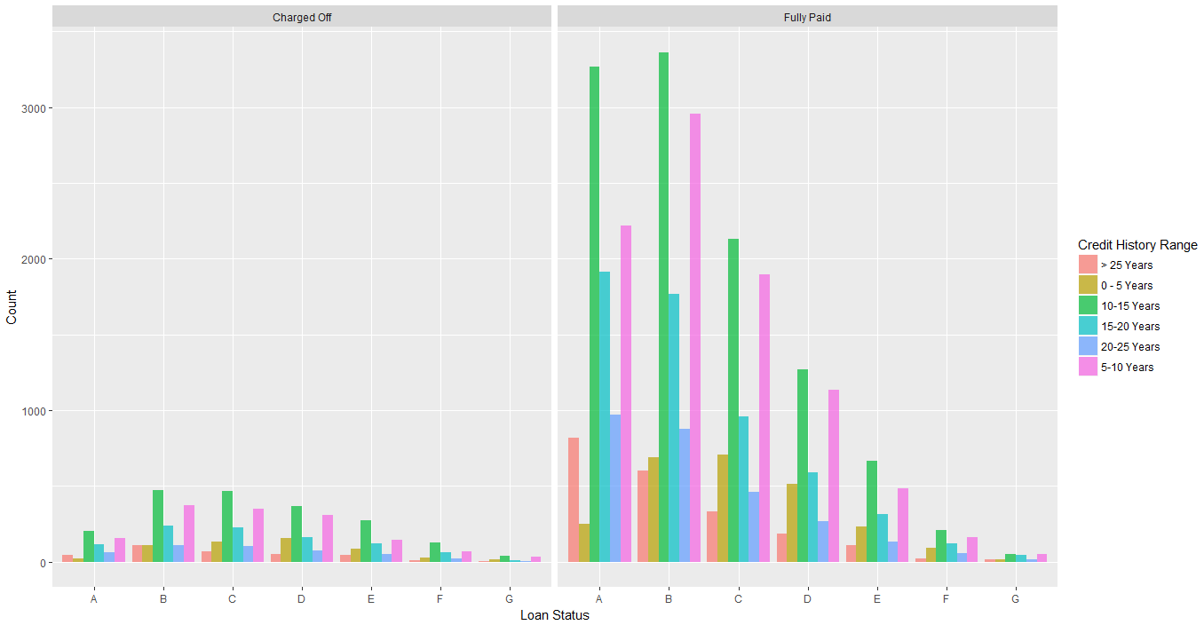
Data Visualizations (These plots help visualize the data in the input file)
Plot showing the number of loans for each grade, status and credit age
Notes:
ggplot(data = uber, aes(
x = factor(Req.timeslot),
fill = factor(uber$Pickup.point)
)) +
geom_bar(alpha = 0.7, position = "dodge")+
xlab("Timeslot") +ylab("Count") +labs(fill = 'Pickup') +facet_grid(.~uber$Status, scales = "free_x")

Slide 6
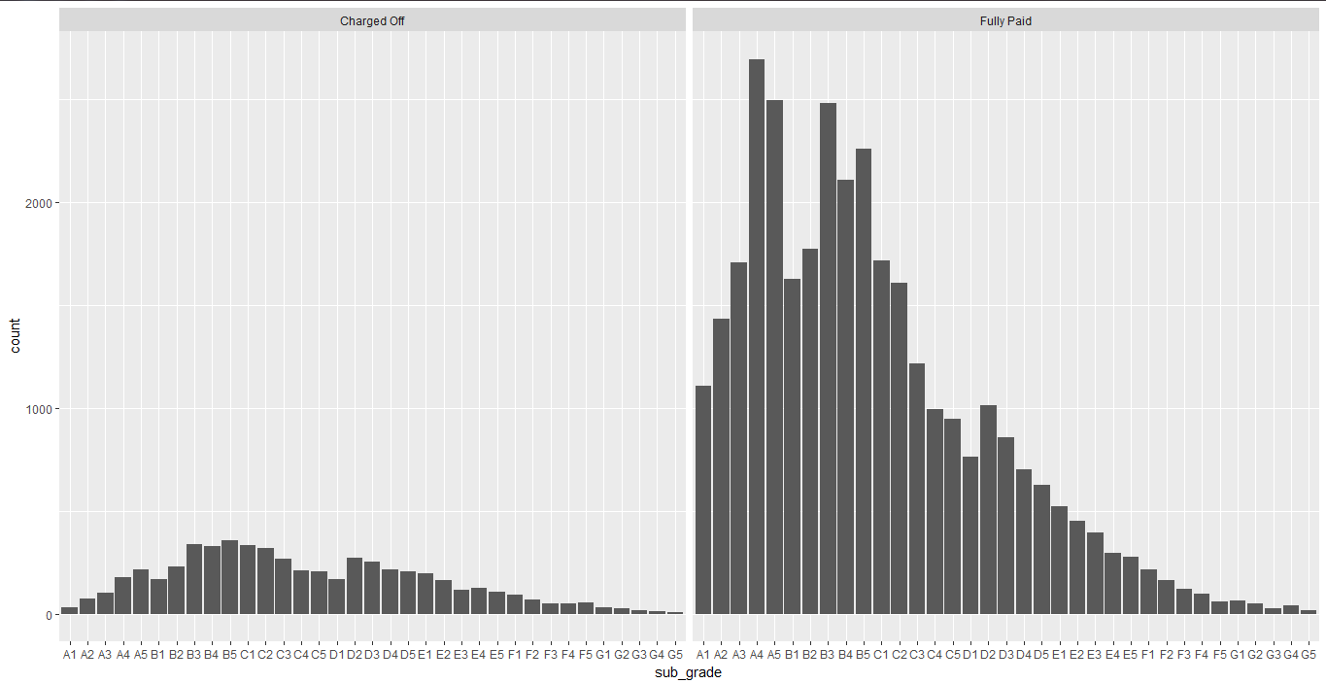
Data Visualizations (These plots help visualize the data in the input file) Cont’d
Plot showing the number of loans for each subgrade and status
Notes:
ggplot(data = uber, aes(
x = factor(Req.timeslot),
fill = factor(uber$Pickup.point)
)) +
geom_bar(alpha = 0.7, position = "dodge")+
xlab("Timeslot") +ylab("Count") +labs(fill = 'Pickup') +facet_grid(.~uber$Status, scales = "free_x")

Slide 7
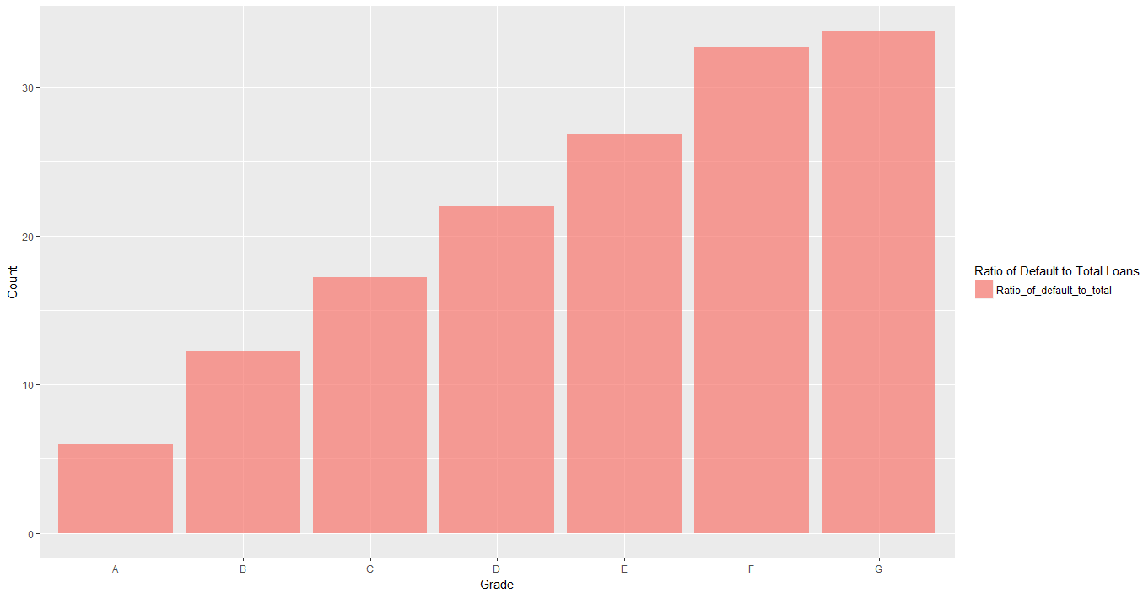
Data Analysis outputs (These plots help visualize the effect of a variable on the chances of default)
Plot showing the ratio of defaults to total number of loans for each grade
Notes:
ggplot(data = uber, aes(
x = factor(Req.timeslot),
fill = factor(uber$Pickup.point)
)) +
geom_bar(alpha = 0.7, position = "dodge")+
xlab("Timeslot") +ylab("Count") +labs(fill = 'Pickup') +facet_grid(.~uber$Status, scales = "free_x")

Slide 8
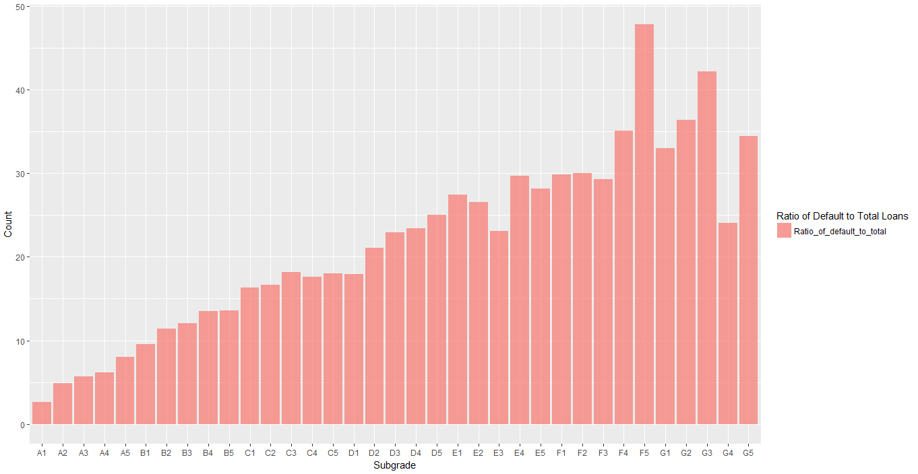
Data Analysis outputs (These plots help visualize the effect of a variable on the chances of default)
Plot showing the ratio of defaults to total number of loans for each subgrade
Notes:
ggplot(data = uber, aes(
x = factor(Req.timeslot),
fill = factor(uber$Pickup.point)
)) +
geom_bar(alpha = 0.7, position = "dodge")+
xlab("Timeslot") +ylab("Count") +labs(fill = 'Pickup') +facet_grid(.~uber$Status, scales = "free_x")

Slide 9
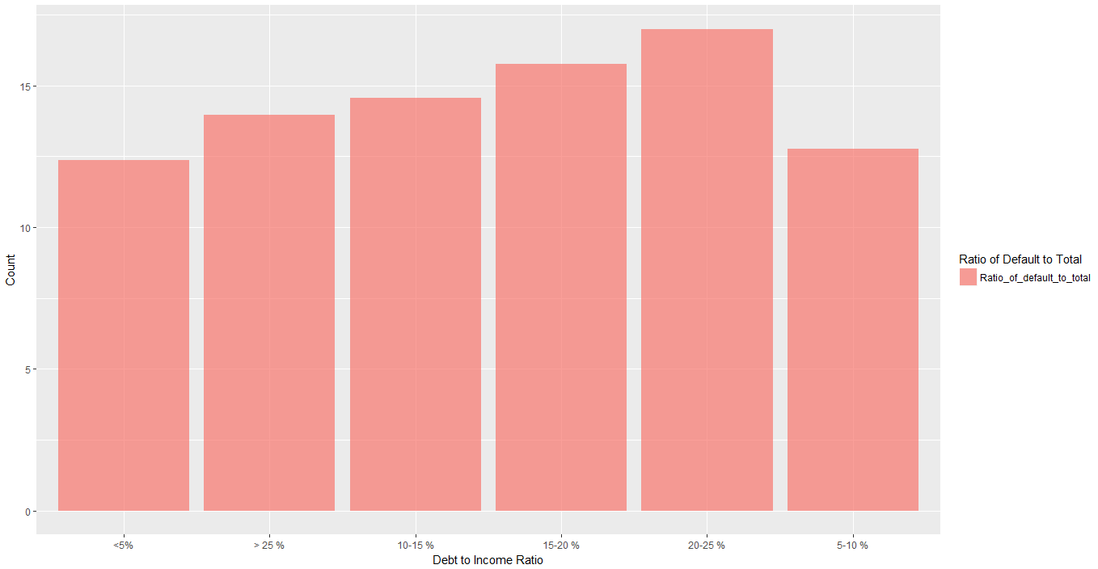
Data Analysis outputs (These plots help visualize the effect of a variable on the chances of default)
Plot showing the ratio of defaults to total number of loans for each dti bucket
Notes:
ggplot(data = uber, aes(
x = factor(Req.timeslot),
fill = factor(uber$Pickup.point)
)) +
geom_bar(alpha = 0.7, position = "dodge")+
xlab("Timeslot") +ylab("Count") +labs(fill = 'Pickup') +facet_grid(.~uber$Status, scales = "free_x")

Slide 10
Analysis of Few other key fields
The following table gives a good understanding of how the Loan status changes based on certain key fields
Loan Status | Median |  |  |  |  |  | Average
 | Funded Amount | Installment | Annual Income | Ratio of obligation to income | # of Credit accounts | Age of Credit | Derogatory records
Charged Off | 10000 | 293.87 | 53000 | 14.29 | 8 | 12 | 0.085
Fully Paid | 9200 | 275.65 | 60000 | 13.2 | 9 | 13 | 0.050

Slide 11
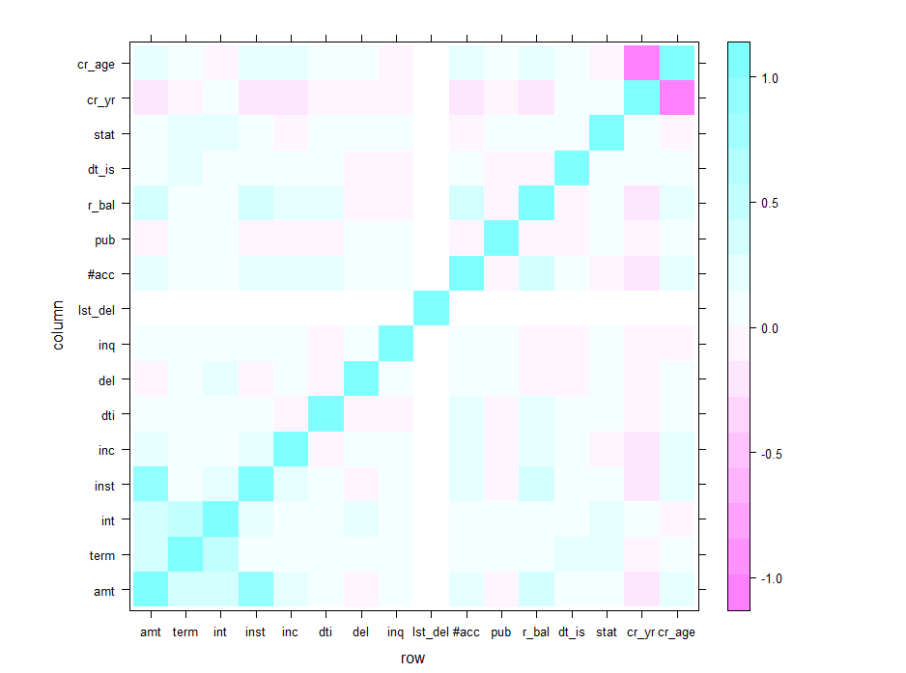
Bivariate Analysis Correlation Plot
Correlation plot showing the correlation of each variable to loan status
Defaulted loans have a positive correlation with
1. Term (% of defaults is high for 60 month loans as compared to 36 month loans) [*term in the plot]
2. Interest Rate (a higher interest rate signals a higher chance of default ) [*int in the plot]
Negative correlation with
1. open_acc (Higher the number of credit accounts, lower the chance of default) [*#acc in the plot]
2. annual_inc (A higher annual income signals a lower default chance) [*inc in the plot]
3. earliest_cr_line (Earlier the ealiest credit line, i.e., greater the age of credit history, lower is the chance of default) [*cr_age in the plot]
Notes:
ggplot(data = uber, aes(
x = factor(Req.timeslot),
fill = factor(uber$Pickup.point)
)) +
geom_bar(alpha = 0.7, position = "dodge")+
xlab("Timeslot") +ylab("Count") +labs(fill = 'Pickup') +facet_grid(.~uber$Status, scales = "free_x")

Slide 12
Conclusions and Recommendations
The following fields seem to have an impact on the probability of a loan getting Charged off (Default). Based on the analysis and plots depicted in previous slides, we can confidently say that the Consumer finance company can base their loan decision using the below parameters and observations mentioned alongside.
S.No. | Field | Field Business Desc | Impact | Observations for default
1 | grade | LC assigned loan grade | VERY HIGH | Lower the grade (E,F etc.), higher the chance of default
2 | subgrade | LC assigned loan subgrade | VERY HIGH | Within a grade, higher subgrade(4,5 etc.) signals higher chance of default
3 | term | # of loan payments | HIGH | 60 month loans have twice (~25%) the chance of default than 36 month loans(~11%)
4 | int_rate | Interest rate of loan | HIGH | Increasing interest rate, increases the chance of default
5 | dti | Debt to inc ratio | HIGH | Increasing dti, increases the chance of default
6 | pub_rec | # of Derorgatory remarks | HIGH | Increasing derogatory remarks, increase the chance of default
7 | open_acc | # of Credit lines open | MEDIUM | Lower the credit lines, higher the chance of default
8 | funded_amnt | Loan amount approved | MEDIUM | Higher the loan amount, higher the chance of default
9 | installment | Monthly installment | MEDIUM | Increasing installment, increases the chance of default
10 | annual_inc | Annual Income | MEDIUM | Lower the income, higher the chance of default
11 | earliest_cr_line | Year of first credit | MEDIUM | Later (YYYY) the first credit line opened, higher is the chance of default

